Slide 1
Flux and Redux
Jason Monroe - 688776

Slide 2
Course Objective:
At the end this 120 min session, you will be able to
Implement Redux in a React Application

Slide 3
Benefits of Redux
Simplifies state handling
Reduces complexity of components
Most popular form of Flux

Slide 4
Key Topics
Overview
Actions
Reducers
Stores
Dispatching
React Implementation

Slide 5
Overview

Slide 6
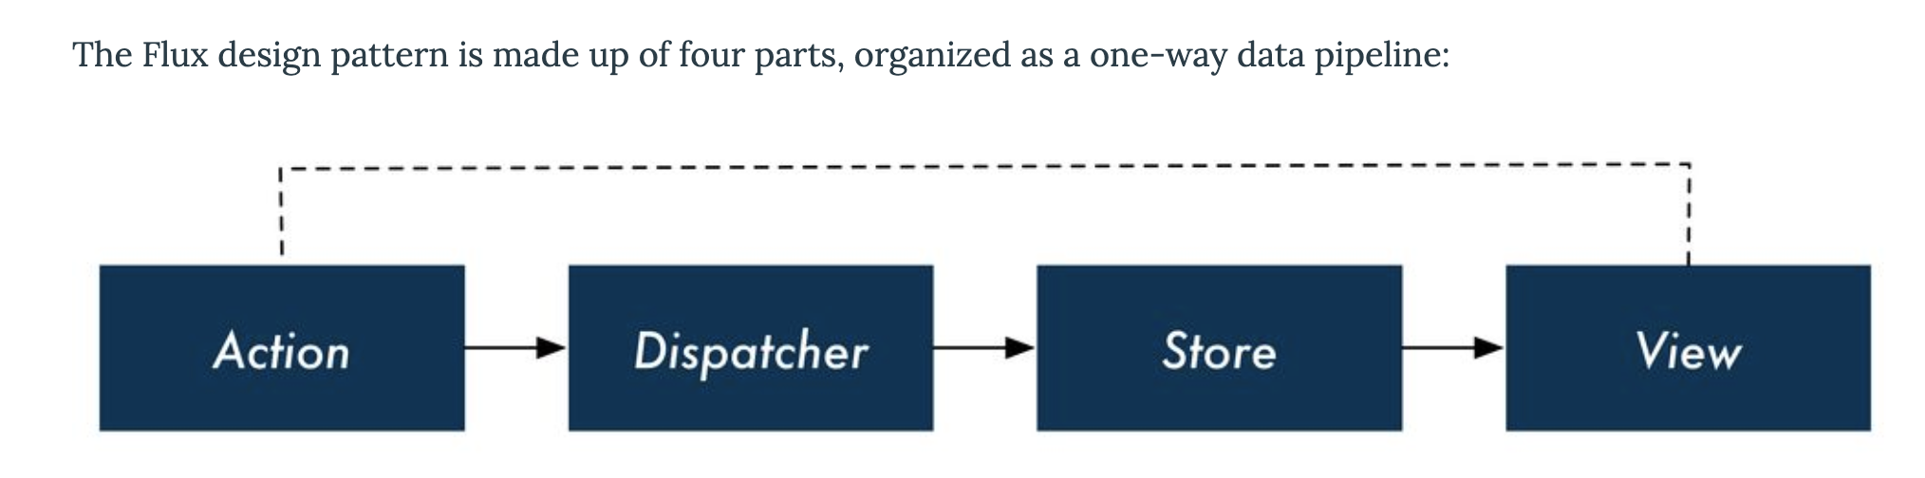
What is Flux?
https://www.newline.co/fullstack-react/p/intro-to-flux-and-redux/

Slide 7
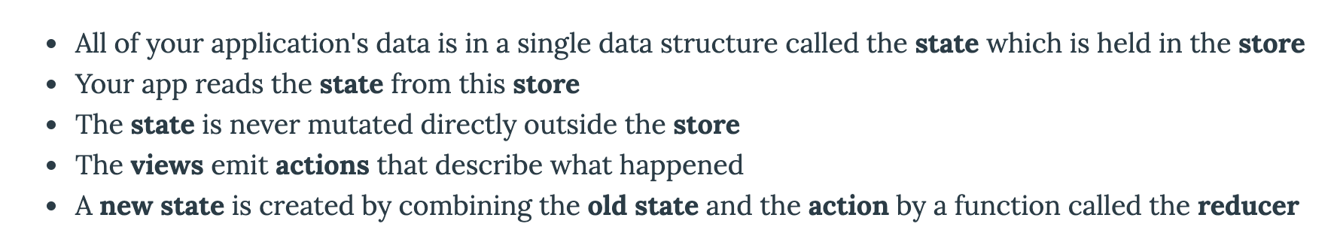
What is Redux?
https://www.newline.co/fullstack-react/p/intro-to-flux-and-redux/

Slide 8
Redux store can connect to any component independently

Slide 9
Actions, Reducers, and Store

Slide 10
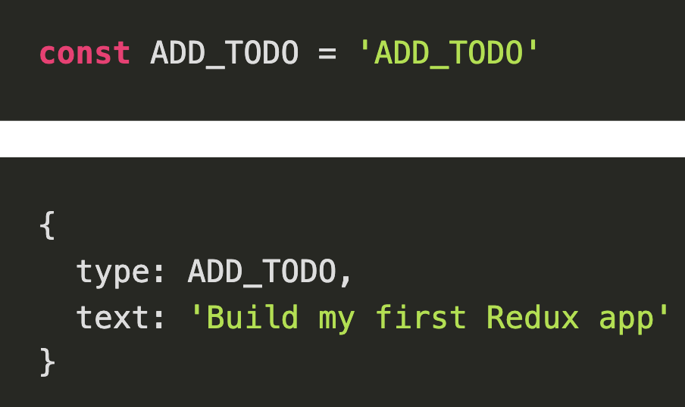
What is an Action?
An Object with a type attribute that is typically a string and other attributes made up of data
Like a verb along with a payload
https://redux.js.org/basics/actions

Slide 11
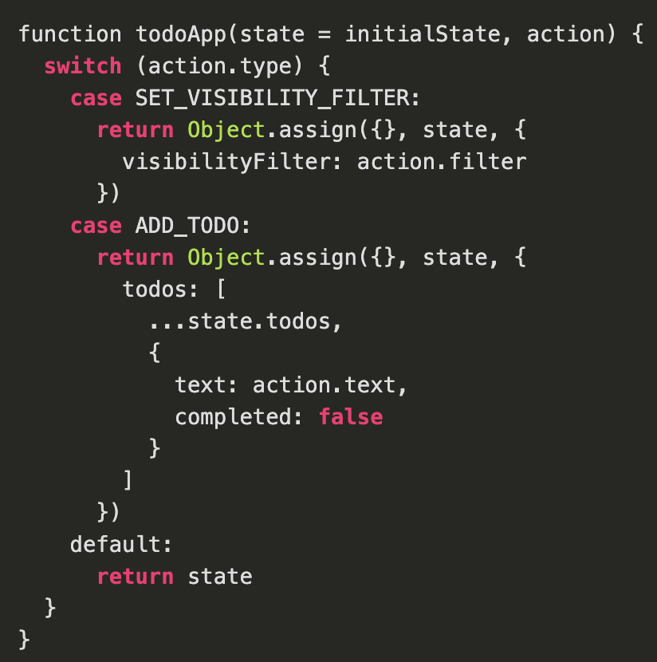
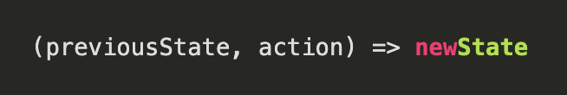
What is a Reducer?
A function that receives the previousState and an action and then outputs the new state
Contains logic on how to update the state
https://redux.js.org/basics/actions

Slide 12
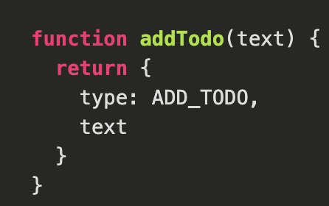
What is an Action Creator?
A method that returns the appropriate action object. Abstracts Action object out of program logic
Makes them portable and testable
https://redux.js.org/basics/actions#action-creators

Slide 13
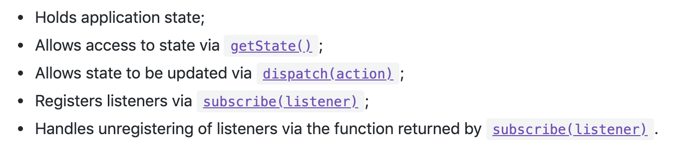
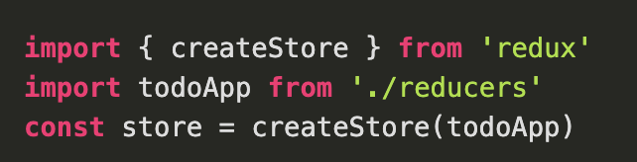
What is the Store
Creating the store with two different overloads

Slide 14
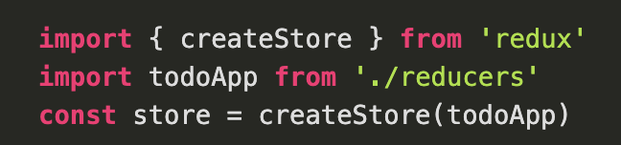
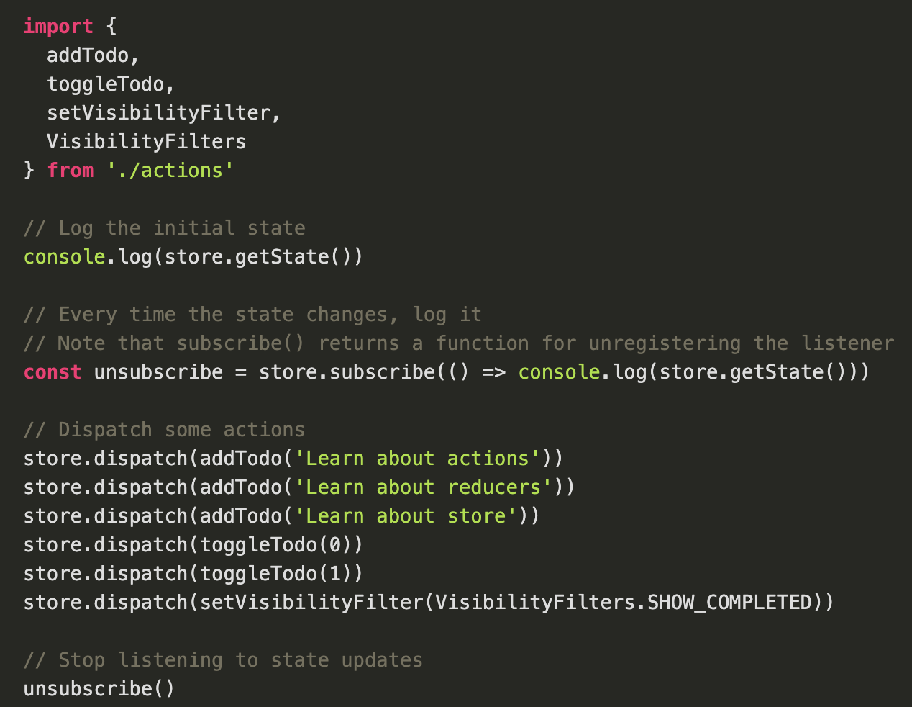
Dispatching an Action
Make a call to an action creator method, passing it the action
Pass that call as the argument to store.dispatch()

Slide 15
Redux and React

Slide 16
Installation
Yarn add redux OR npm install redux
Yarn add react-redux OR npm install react-redux
Yarn add redux-actions OR npm install redux-actions

Slide 17
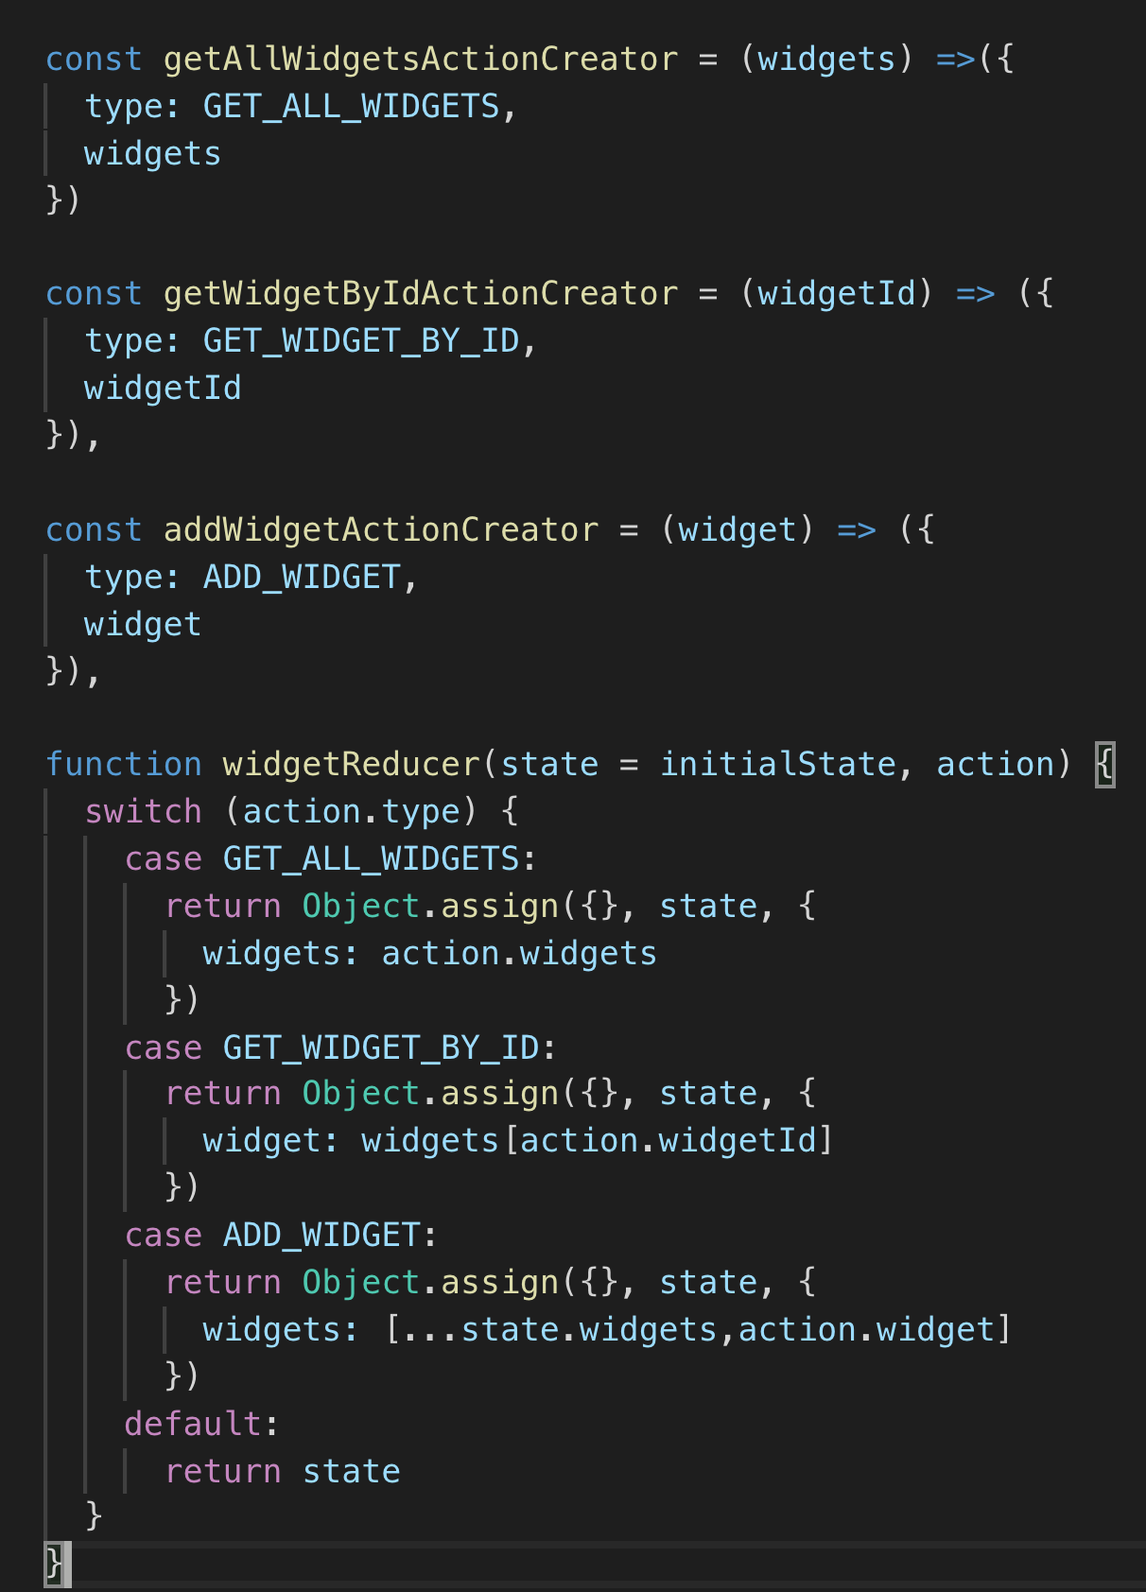
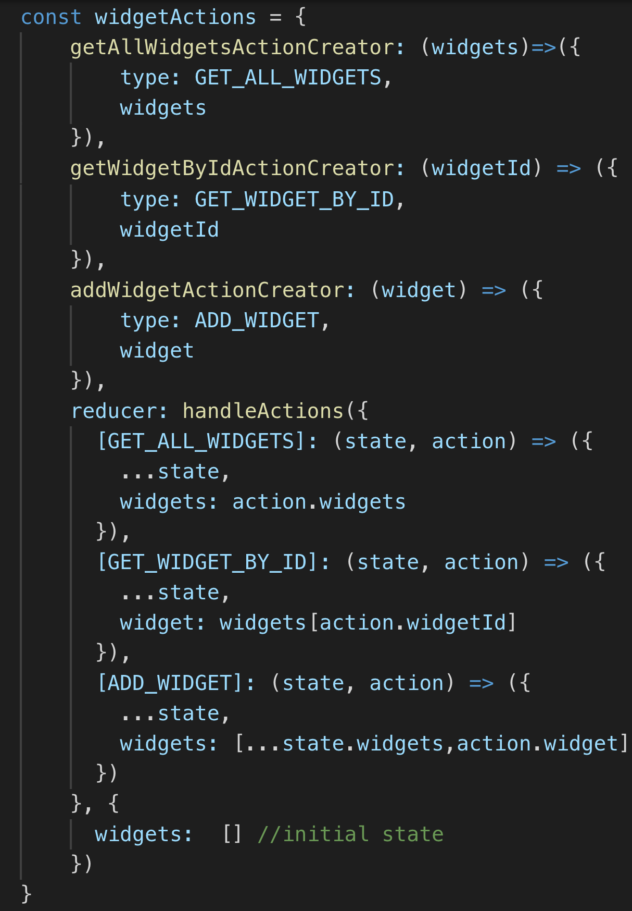
Actions and Reducers using Redux-Actions
Notes:
Switch/case is considered an antipattern. Use a robust object instead

Slide 18
Actions and Reducers using Redux-Actions
Single object with action creators and reducers
Action creators can be called by accessing the appropriate property
Reducer property bundles reducers as a single object
https://redux-actions.js.org/introduction/tutorial

Slide 19
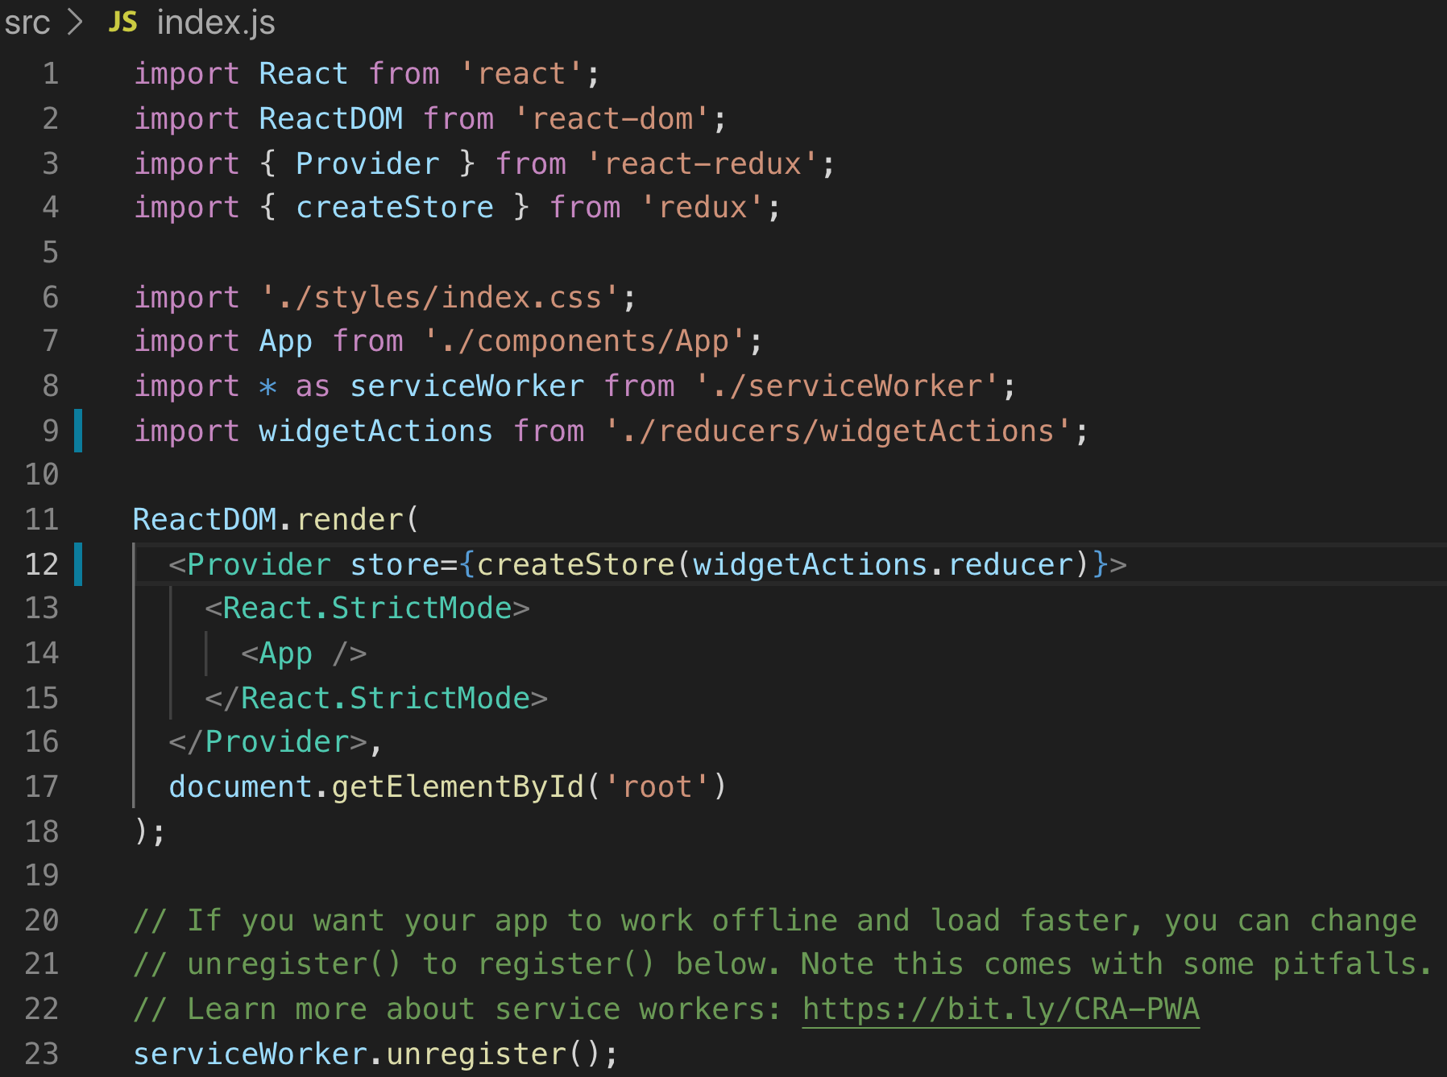
Creating Store and Providing to App
Do this in index.js
Provider tag wraps <App /> and makes store available to entire app
reducer property from robust object

Slide 20
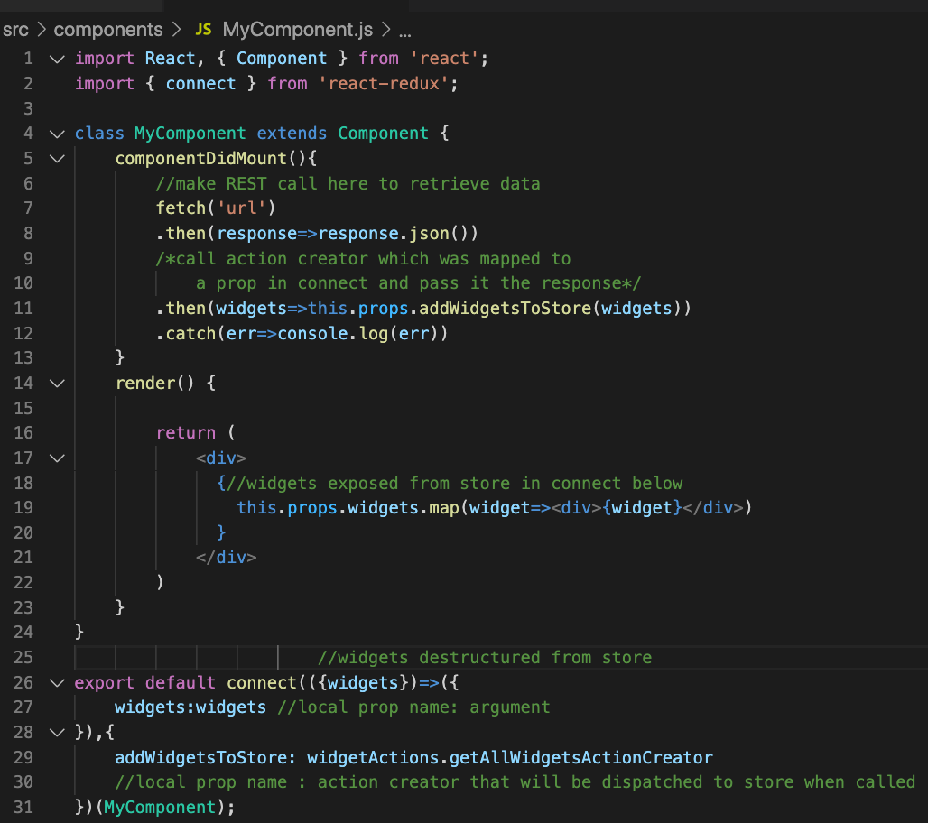
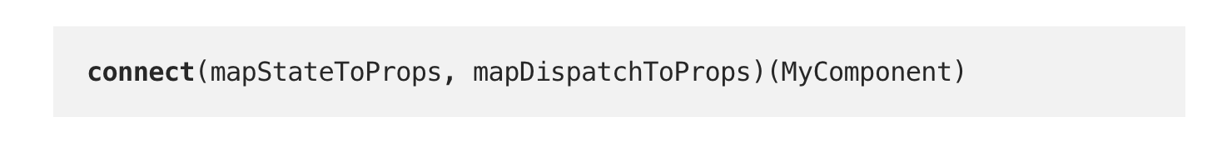
Connect Component to Store
import connect from ‘react-redux’
Access store in a lifecycle method, calling actionCreator
Connect method call on export injecting dispatch and exposing actionCreator to component
https://blog.benestudio.co/5-ways-to-connect-redux-actions-3f56af4009c8
https://javascript.info/currying-partials

Slide 21

Code Along Practice – Converting hello-react to Redux
Install redux, react-redux, redux-actions
Reorganize project structure into components, models, reducers and tests folders
Create reducer and action creator for getAllDevelopers and using handleActions from react-actions
Create store and provider for app
Move componentDidMount() with fetch call to DisplayBios.js. Demote App component to functional component, elevate DisplayBios component to class.
Connect DeveloperBios.js component to store, accessing its getAllDevelopers action creator in componentDidMount and exposing developers to the component

Slide 22
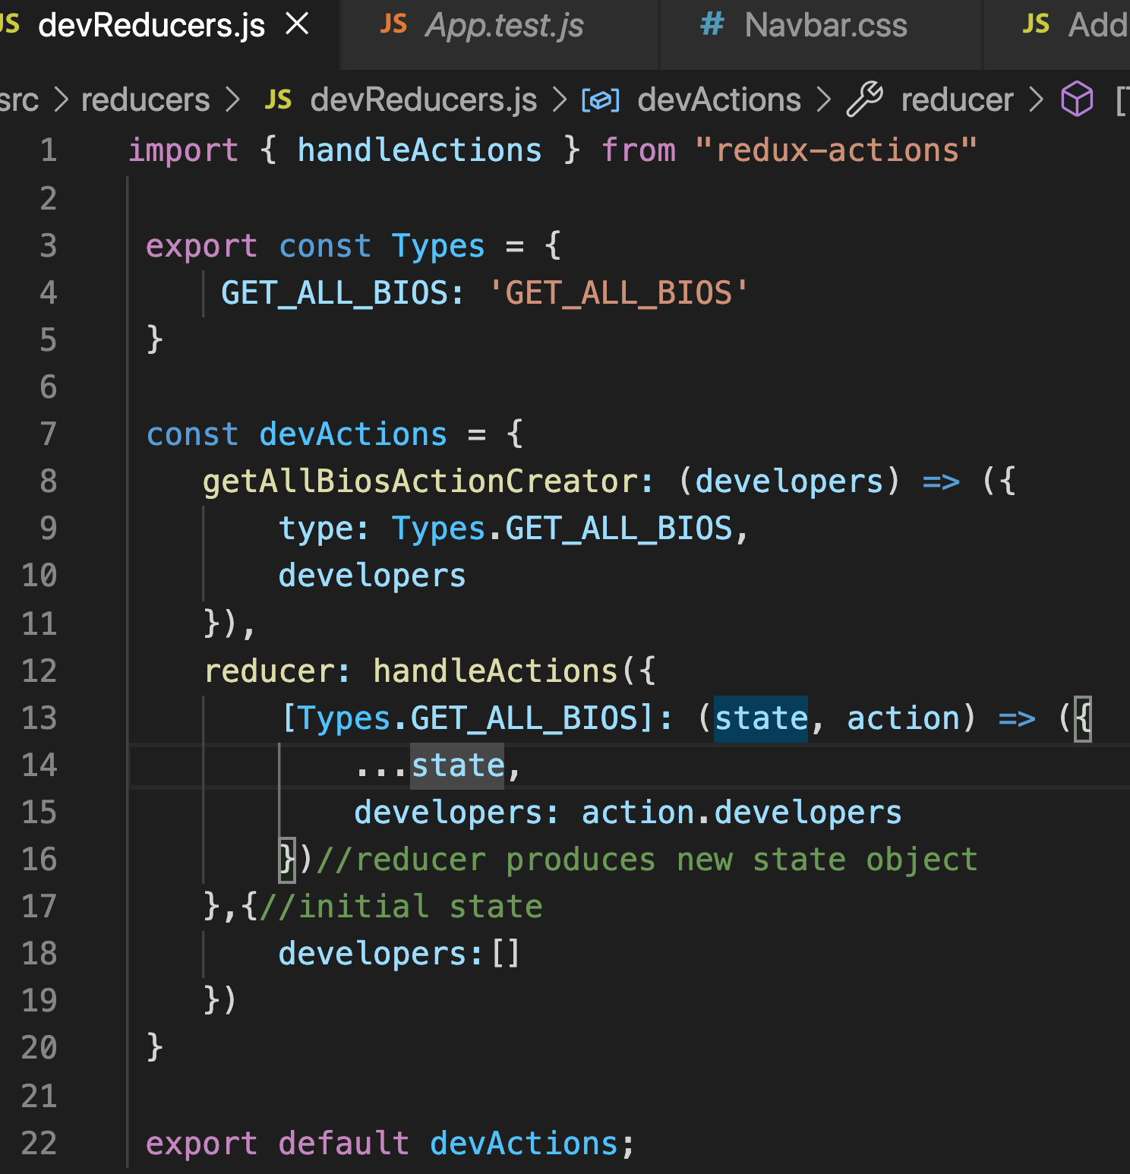
devReducers.js

Slide 23
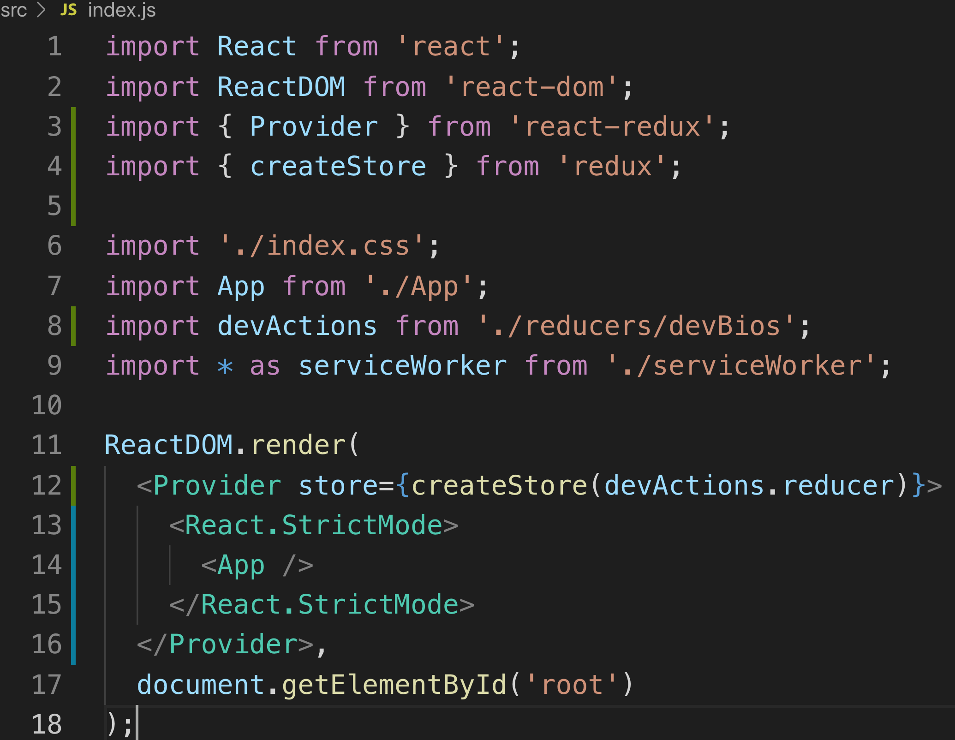
index.js

Slide 24
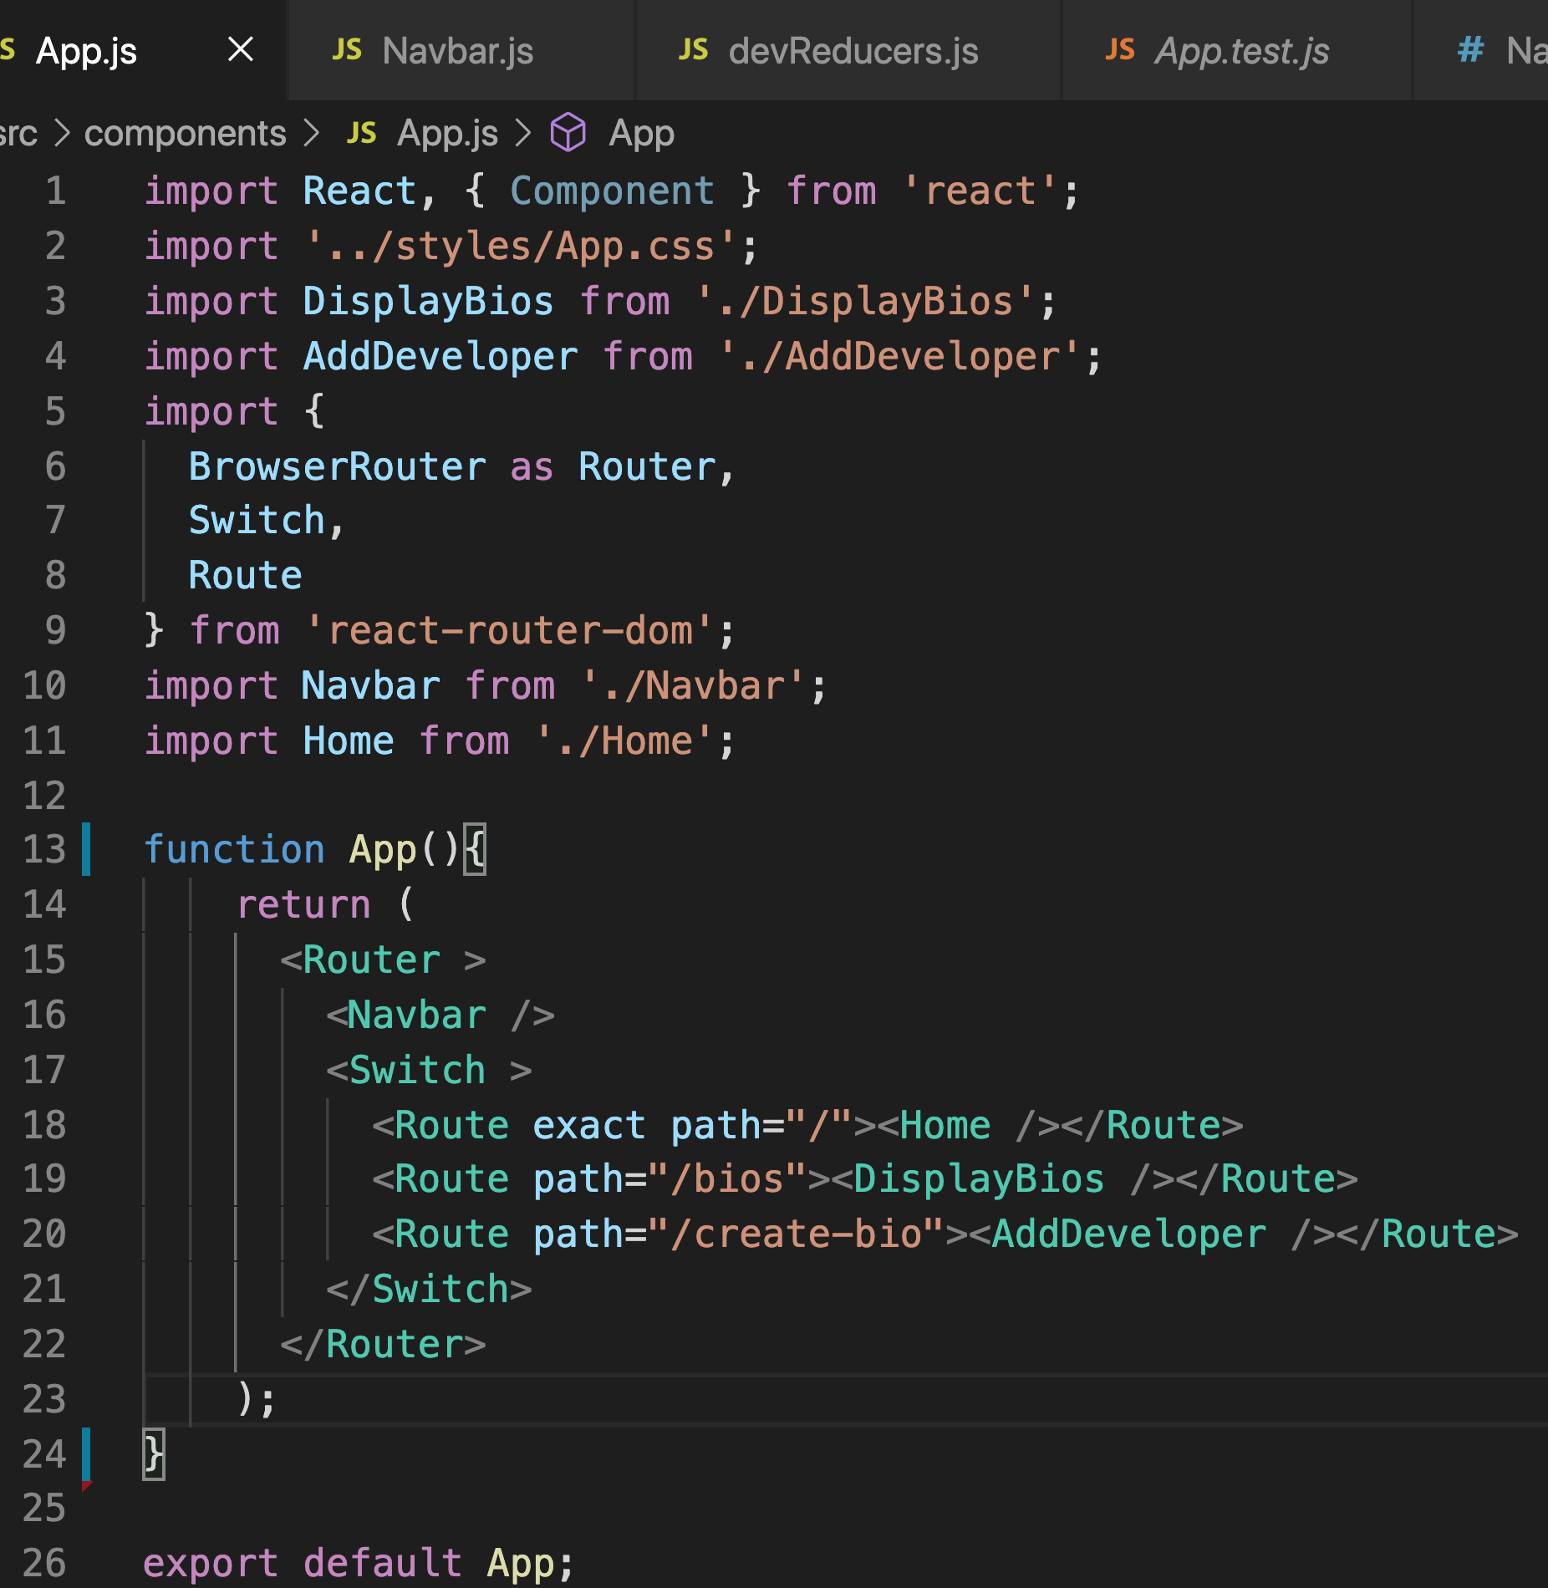
App.js

Slide 25
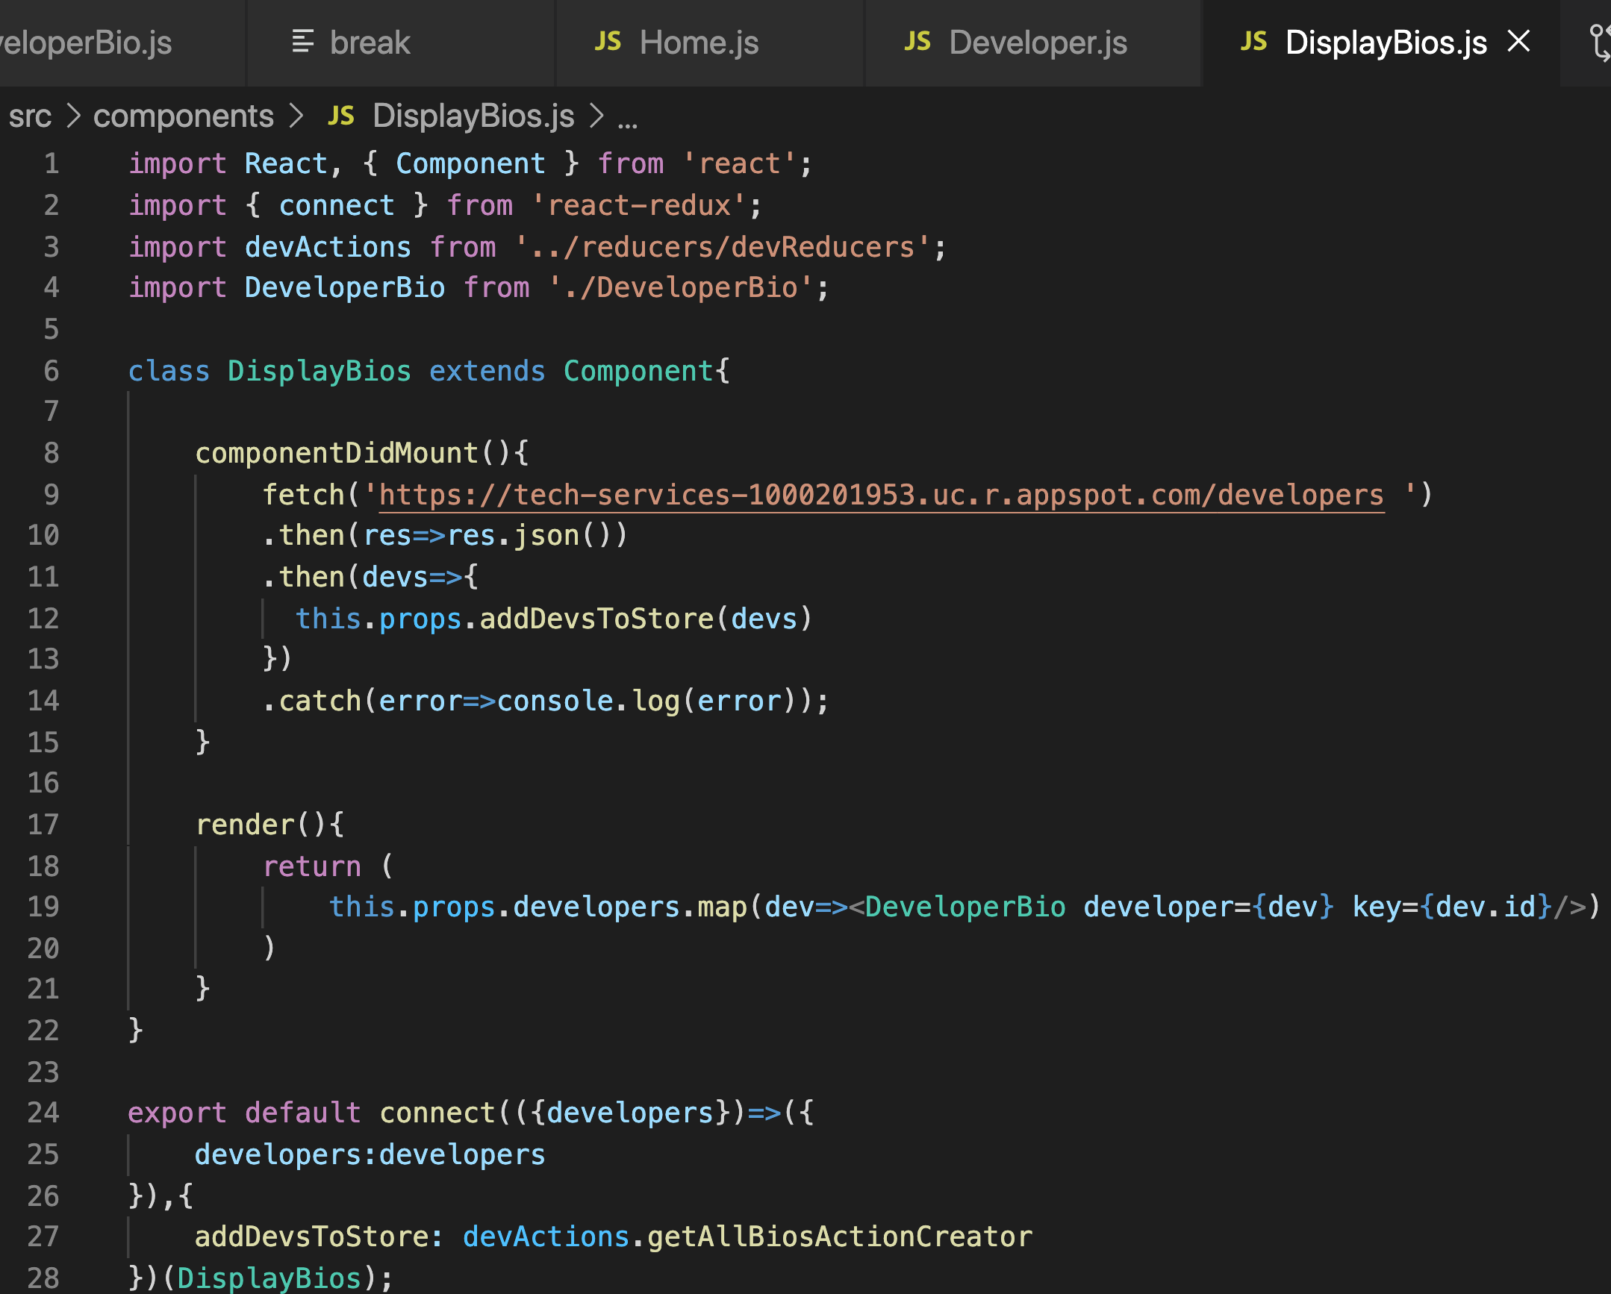
DeveloperBios.js

Slide 26
On Your Own

Slide 27
On Your Own
Convert your Todos-React project into a React-Redux project.
Create Todos action creators and reducer for Add, Edit, and Delete
Create a store with those reducers and provide it to app
Connect components and call action creators from lifecycle methods

Slide 28
Review
Actions
Reducers
Stores
Provider
Connect

Slide 29
Course Objective:
At the end this 150 min session, you will be able to
Implement Redux in a React application

Slide 30
Why wouldn’t an app use Redux?
How difficult was it to convert to Redux?

Slide 31
Thank You

